Slide 1
Max Clique
CS452
By Cole Determan and Gavin Barro

Slide 2
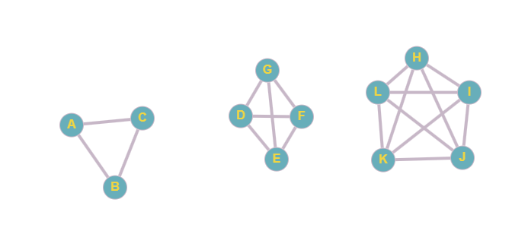
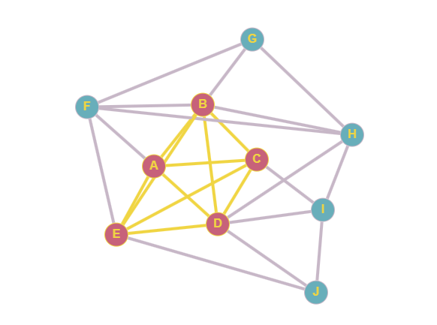
The Problem
Given a small graph with N nodes and E edges, the task is to find the maximum clique in the given graph.
A clique is a complete subgraph of a given graph. This means that all nodes in the said subgraph are directly connected to each other, or there is an edge between any two nodes in the subgraph.
The maximal clique is the complete subgraph of a given graph which contains the maximum number of nodes.
Figure 1: Examples of a clique ranging from 1 - 3 vertices.
Figure 2: Example of a max clique (5 vertices) in a graph.
Notes:
https://www.geeksforgeeks.org/maximal-clique-problem-recursive-solution/ https://graphonline.top/en/

Slide 3
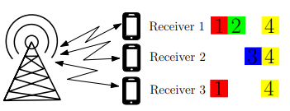
Why it’s important
The max clique algorithm is used in different fields like;
Bioinformatics: The algorithm compares protein structures by finding common subgraphs.
Communications & Signal Processing: The algorithm optimizes resource allocation in networks.
Information Retrieval: The algorithm clusters similar data items, improving organization and efficiency.
Figure 3: Example of max clique in multiple access networks.
Notes:
Salari, S., & Sharifi, M. (2018). A survey on resource allocation in non-orthogonal multiple access networks: Current status and challenges. arXiv. https://doi.org/10.48550/arXiv.1808.07102

Slide 4
Decision Problem & Optimization Problem
Sample Max Clique input:
2
a b
b c
Decision Problem: Does a clique of size k exist in the graph?
Output: True if there is a clique of at least k vertices in the graph, else False.
Optimization Problem: What is the max size of a clique in the graph?
Output: The largest clique.
Sample Max Clique output:
a b

Slide 5
Certifier Process is polynomial:
Certifier: is_clique
Explanation:
def is_clique(graph, vertices):
for v in vertices:
for u in vertices:
if u != v and u not in graph[v]:
return False
return True
Iterate through each pair in the graph, which takes O(k²) time and verifies that all corresponding edges exist. Since k ≤ |V| and |V| is polynomial in the size of the input, the checking procedure is a polynomial-time certifier.

Slide 6
Analytical (Big-O) Runtime Analysis
Branching on Candidates: At each step of recursion, it chooses a candidate vertex to either include or exclude.
Pruning: Some branches can be cut early if they don’t lead to a larger clique than one that’s already been found, but this doesn’t change the worst-case complexity.
Worst Case: For a sufficiently large graph without effective pruning (like a complete graph), the algorithm would explore a large number of subsets.
Time complexity can be approximated by O(2^{|v|}) in the worst case.
new_candidates = [u for u in candidates if u in graph[v]]
backtrack_max_clique(graph, new_candidates, current_clique, best_clique)
For each candidate vertex v, it generates a new candidate list new_candidates (which can be up to O(|V|) and then recurse. This can lead to an exponential number of subsets.

Slide 7
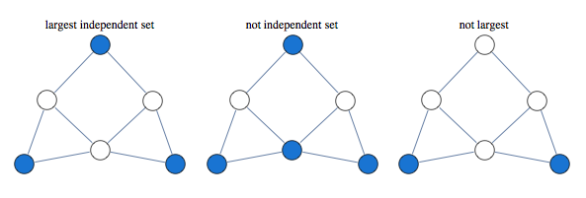
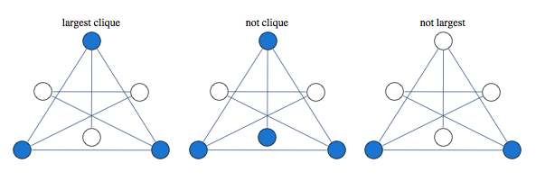
Reduction from a known NP-Hard
The max-clique problem is a reduction from the Maximum Independent Set problem, which is known to be NP-hard.
Given an instance of the Max Ind Set problem, construct the complement graph using the same vertex set.
Notes:
https://yaroslavvb.blogspot.com/2011/03/linear-programming-for-maximum.html

Slide 8
Exact Solution - Code
def backtrack_max_clique(graph: Graph, candidates: list[str], current_clique: list[str],
best_clique: list[list]) -> None:
if not candidates:
# Check if current_clique is the largest so far
if len(current_clique) > len(best_clique[0]):
best_clique[0] = current_clique[:]
return
if len(current_clique) + len(candidates) <= len(best_clique[0]):
return
while candidates:
v = candidates.pop()
if all((u in graph[v]) for u in current_clique):
new_candidates = [u for u in candidates if u in graph[v]]
current_clique.append(v)
backtrack_max_clique(graph, new_candidates,
current_clique, best_clique)
current_clique.pop()

Slide 9
Exact Solution - PseudoCode
backtrack_max_clique(graph, candidates, current_clique, best_clique):
If no candidates left:
Check if current_clique is bigger than best_clique so far:
If yes, replace best_clique with a copy of current_clique.
Return.
If size of current_clique + size of remaining candidates is <= size of best_clique:
There isn’t a larger clique possible, so return.
While there are candidates left:
Take the last candidate (v) from the list.
Check if that candidate (v) connects to every node in current_clique:
If yes, then create a new list of candidates only connected to v,
Then add v to the current_clique. Then, recursively call this function
With the updated values and after returning, remove v from current_clique.
Move to the next candidate even if v doesn’t fit.

Slide 10
Approximate Solution - Code
def find_max_clique_approx(graph: Graph) -> list[str]:
if not graph:
return []
vertices = sorted(graph.keys(), key=lambda v: len(graph[v]), reverse=True)
best_clique = []
for vertex in vertices:
clique = [vertex]
candidates = list(graph[vertex])
while candidates:
candidates.sort(key=lambda c: len(graph[c]), reverse=True)
chosen = None
for c in candidates:
if all((c in graph[u]) for u in clique):
chosen = c
break
if chosen:
clique.append(chosen)
candidates = [
u for u in candidates if u in graph[chosen] and u != chosen]
else:
break
if len(clique) > len(best_clique):
best_clique = clique
return best_clique

Slide 11
Approximate Solution - PseudoCode
find_max_clique_approx(graph): Start with an empty list to track the largest clique so far (biggest_clique)
Sort all vertices in the graph by the number of neighbors they have, in descending order (greedy)
For each vertex in the sorted list:
Get the neighbors of the vertex.
Combine the vertex and its neighbors into a maybe clique.
Check if maybe_clique is a valid clique using the is_clique function.
If it is a clique and is larger than the biggest clique so far:
Replace biggest_clique with maybe_clique
Return the largest clique found (biggest_clique)

Slide 12
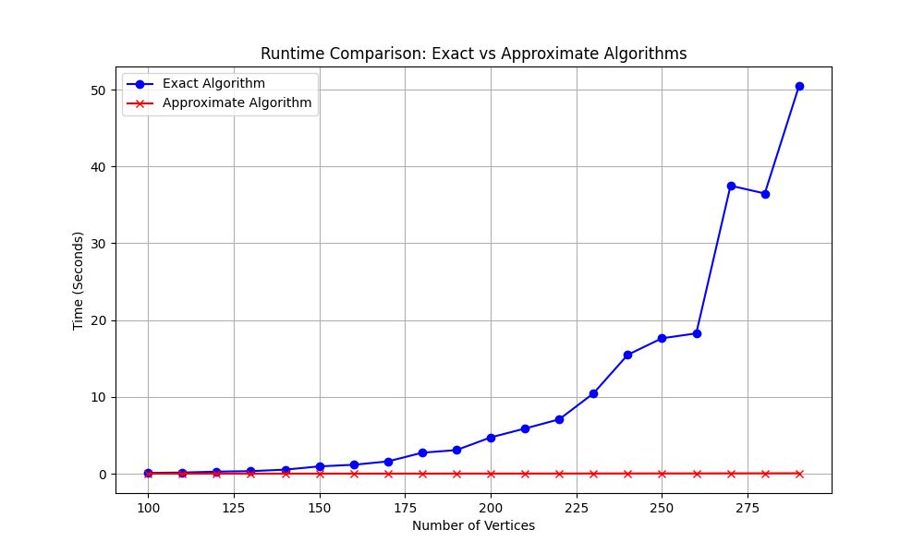
Runtime Comparison

Slide 13
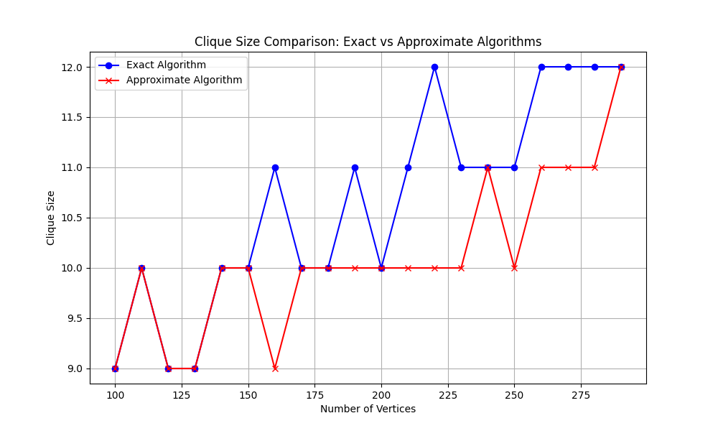
Output Comparison

Slide 14
Worst Case
def worst_case_graph() -> None:
num_vertices = 1200
start_time = time.time()
# Generate large graph and find max clique
large_graph = generate_worst_case_graph(num_vertices)
max_clique = exact.find_max_clique_exact(large_graph)
end_time = time.time()
# Calculate the time
elapsed_time = end_time - start_time
minutes = int(elapsed_time // 60)
seconds = int(elapsed_time % 60)
print("Max clique:", exact.format_graph(max_clique))
print(f"Time taken: {minutes} minutes and {seconds} seconds")
sys.setrecursionlimit(5000)
def generate_worst_case_graph(num_vertices: int) -> Graph:
graph = {str(i): [] for i in range(num_vertices)} # Create # vertices labeled 0, 1, 2, ..., num_vertices-1
for i in range(num_vertices):
for j in range(i + 1, num_vertices): # Avoid self-loops
graph[str(i)].append(str(j))
graph[str(j)].append(str(i))
return graph
Why this is the worst case:
In a complete graph, every subset forms a clique
The algorithm must evaluate all 2^{n} subsets to find the largest clique
No pruning opportunities because every edge exists in the graph, so any optimizations become obsolete

Slide 15
Output:
Max clique: 1199 1198 1197 1196 1195 1194 1193 1192 1191 1190 1189 1188 1187 1186 1185 1184 1183 1182 1181 1180 1179 1178 1177 1176 1175 1174 1173 1172 1171 1170 1169 1168 1167 1166 1165 1164 1163 1162 1161 1160 1159 1158 1157 1156 1155 1154 1153 1152 1151 1150 1149 1148 1147 1146 1145 1144 1143 1142 1141 1140 1139 1138 1137 1136 1135 1134 1133 1132 1131 1130 1129 1128 1127 1126 1125 1124 1123 1122 1121 1120 1119 1118 1117 1116 1115 1114 1113 1112 1111 1110 1109 1108 1107 1106 1105 1104 1103 1102 1101 1100 1099 1098 1097 1096 1095 1094 1093 1092 1091 1090 1089 1088 1087 1086 1085 1084 1083 1082 1081 1080 1079 1078 1077 1076 1075 1074 1073 1072 1071 1070 1069 1068 1067 1066 1065 1064 1063 1062 1061 1060 1059 1058 1057 1056 1055 1054 1053 1052 1051 1050 1049 1048 1047 1046 1045 1044 1043 1042 1041 1040 1039 1038 1037 1036 1035 1034 1033 1032 1031 1030 1029 1028 1027 1026 1025 1024 1023 1022 1021 1020 1019 1018 1017 1016 1015 1014 1013 1012 1011 1010 1009 1008 1007 1006 1005 1004 1003 1002 1001 1000 999 998 997 996 995 994 993 992 991 990 989 988 987 986 985 984 983 982 981 980 979 978 977 976 975 974 973 972 971 970 969 968 967 966 965 964 963 962 961 960 959 958 957 956 955 954 953 952 951 950 949 948 947 946 945 944 943 942 941 940 939 938 937 936 935 934 933 932 931 930 929 928 927 926 925 924 923 922 921 920 919 918 917 916 915 914 913 912 911 910 909 908 907 906 905 904 903 902 901 900 899 898 897 896 895 894 893 892 891 890 889 888 887 886 885 884 883 882 881 880 879 878 877 876 875 874 873 872 871 870 869 868 867 866 865 864 863 862 861 860 859 858 857 856 855 854 853 852 851 850 849 848 847 846 845 844 843 842 841 840 839 838 837 836 835 834 833 832 831 830 829 828 827 826 825 824 823 822 821 820 819 818 817 816 815 814 813 812 811 810 809 808 807 806 805 804 803 802 801 800 799 798 797 796 795 794 793 792 791 790 789 788 787 786 785 784 783 782 781 780 779 778 777….
Time taken: 36 minutes and 0 seconds

Slide 16
Citations
https://yaroslavvb.blogspot.com/2011/03/linear-programming-for-maximum.html
https://doi.org/10.48550/arXiv.1808.07102
https://www.geeksforgeeks.org/maximal-clique-problem-recursive-solution/
https://graphonline.top/en/

